Slide 1
Using an outcome tree to display outcomes for two events
Probability: possible outcomes

Slide 2
How our teaching resources are designed for the classroom

Slide 3
I can systematically find all the possible outcomes for two events by using an outcome tree diagram.

Slide 4
Tree diagrams are a representation used to model statistical/probability questions. Branches represent different possible events or outcomes.
Each branch of an outcome tree shows a possible outcome from an event or from a stage of a trial. The full outcome tree shows all possible outcomes.
A sample space is all the possible outcomes of a trial. A sample space diagram is a systematic way of producing a sample space.

Slide 5

Using an outcome tree to display outcomes for two events
Outcome trees for two-stage trials
Outcome trees from two events

Slide 6
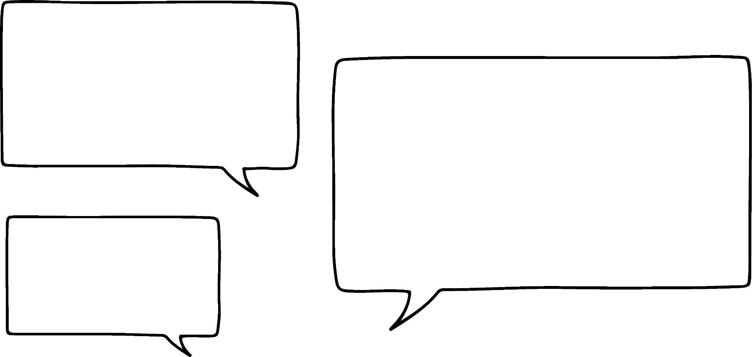


Outcome trees for two-stage trials
Spinners 1 and 2 will both be spun once.
List all the possible outcomes.
I wish there was a way of making sure I’ve listed all the outcomes from this trial.
C
A
B
A
I know you can use a two-way table, but I wish there was a way of breaking it down more.
B
Sofia
spinner 1
spinner 2
AA
AB
AC
BA
BB
BC
outcomes
Jun

Slide 7
Outcome trees for two-stage trials
An outcome tree helps show the outcomes of a trial.
We can treat an outcome tree as a timeline of possible outcomes.
B
A
A
A
B
spinner 1
C
C
A
Starting
point
A
B
B
B
C
spinner 2

Slide 8
Outcome trees for two-stage trials
outcomes from spinner 2
B
A
outcomes from spinner 1
A
outcomes from spinner 2 after spinner 1 landed on A
A
B
spinner 1
C
C
A
A
outcomes from spinner 2 after spinner 1 landed on B
B
B
B
C
spinner 2

Slide 9
Outcome trees for two-stage trials
This is a cool set of scenarios showing what could happen!
B
A
A
A
B
spinner 1
C
But where does it show the outcomes of the whole trial?
Jun
C
A
A
B
B
B
C
spinner 2

Slide 10
Outcome trees for two-stage trials
If we traverse each possible path, we’ll end up seeing all possible outcomes of this trial.
sample space
B
A
outcomes
A
A
A
This is the sample space it shows all the possible outcomes of this trial.
A
B
A
B
spinner 1
C
A
C
C
A
A
B
A
B
B
B
B
B
C
B
C
spinner 2

Slide 11


Outcome trees for two-stage trials
What does the highlighted pair of branches represent?
Spinner B lost
a
D
A
b
Spinner 1 lost
C
B
c
Spinner 1 landed on B and lose
win
A
spinner 1
lose
win
d
Spinner 1 landed on B, spinner 2 landed on lose
B
lose
lose
win
C
e
Spinner 1 landed on B because spinner 2 landed on lose
D
spinner 2

Slide 12

Outcome trees for two-stage trials
1) This spinner will be spun once.
Complete the outcome tree for this single-stage trial.
2) Spinners 1 and 2 will be spun once each.
Z
X
B
A
Y
spinner 1
spinner 2
E
A
D
B
A
a) What do the two branches in the box represent?
b) Complete this outcome tree.
C
A
Y
Z
E

Slide 13
Outcome trees for two-stage trials
3) Spinner 3 will be spun twice.
a) Complete the outcome tree.
b) Complete the sample space of outcomes for this outcome tree.
4) Spinners 4 and 5 are spun once each and have these outcomes:
spinner 4 = {A, B}
spinner 5 = {red, blue}
Complete this outcome tree and sample space.
R
P
Q
spinner 3
PP
PQ
PR
QP
QQ
QR
RP
RQ
RR
P
Q
R
P
Q
R
sample space

Slide 14
Outcome trees for two-stage trials
5) Spinners 6 and 7 will be spun once each.
Complete the outcome tree from its sample space.
6) Spinners 8 and 9 will be spun once each.
Fill in the outcomes of each spinner from the outcome tree.
T
spinner 8
sample space
G, win
G, lose
G, draw
H, win
H, lose
H, draw
D
D
T
spinner 9
D
U
V
E

Slide 15
Outcome trees for two-stage trials
1) This spinner will be spun once.
Complete the outcome tree for this single-stage trial.
2) Spinners 1 and 2 will be spun once each.
Z
X
B
A
Y
spinner 1
spinner 2
E
A
D
B
A
X
a) What do the two branches in the box represent?
b) Complete this outcome tree.
C
A
Y
B
Z
C
X
The two outcomes from spinner 1.
D
B
Y
Z
E

Slide 16
Outcome trees for two-stage trials
3) Spinner 3 will be spun twice.
a) Complete the outcome tree.
b) Complete the sample space for this outcome tree.
4) Spinners 4 and 5 are spun once each and have these outcomes:
spinner 4 = {A, B}
spinner 5 = {red, blue}
Complete this outcome tree and sample space.
R
P
Q
spinner 3
P
PP
PQ
PR
QP
QQ
QR
RP
RQ
RR
P
Q
R
A, red
A, blue
B, red
B, blue
red
P
A
blue
Q
Q
R
red
P
B
R
Q
blue
R
sample space

Slide 17
Outcome trees for two-stage trials
5) Spinners 6 and 7 will be spun once each.
Complete the outcome tree from its sample space.
6) Spinners 8 and 9 will be spun once each.
Fill in the outcomes of each spinner from the outcome tree.
T
U
V
spinner 8
sample space
G, win
G, lose
G, draw
H, win
H, lose
H, draw
D
win
E
D
T
G
lose
spinner 9
draw
D
U
win
H
lose
draw
V
E

Slide 18
Using an outcome tree to display outcomes for two events
Outcome trees for two-stage trials
Outcome trees from two events

Slide 19
Outcome trees from two events
6
1
Outcome trees are also very useful in categorising all of the outcomes of a trial into different events.
5
2
4
3
even
This spinner will be spun once.
The possible outcomes are:
1
3
5
2
4
6
2, 4, 6
odd
1, 3, 5
The spinner could land on either an even or odd number.

Slide 20
Outcome trees from two events
6
1
Outcome trees are also very useful in categorising all of the outcomes of a single-event trial into different events.
5
2
4
3
factors of 6
even
This spinner will be spun once.
The possible outcomes are:
2, 6
1
3
5
2
4
6
2, 4, 6
not factors of 6
4
factors of 6
odd
1, 3
1, 3, 5
not factors of 6
5
Of the even numbers the spinner could land on, which ones are factors of 6?

Slide 21
Outcome trees from two events
6
1
Outcome trees are also very useful in categorising all of the outcomes of a single-event trial into different events.
5
2
4
3
factors of 6
even
This spinner will be spun once.
The possible outcomes are:
2, 6
1
3
5
2
4
6
2, 4, 6
not factors of 6
4
factors of 6
odd
1, 3
1, 3, 5
not factors of 6
Event 1: even (or not even)
5

Slide 22
Outcome trees from two events
6
1
Outcome trees are also very useful in categorising all of the outcomes of a single-event trial into different events.
5
2
4
3
factors of 6
even
This spinner will be spun once.
The possible outcomes are:
2, 6
1
3
5
2
4
6
2, 4, 6
not factors of 6
4
factors of 6
odd
1, 3
1, 3, 5
not factors of 6
5
Event 2: factor of 6 (or not)

Slide 23
Outcome trees from two events
6
1
Outcome trees are also very useful in categorising all of the outcomes of a single-event trial into different events.
5
2
4
3
factors of 6
even
This spinner will be spun once.
The possible outcomes are:
2, 6
1
3
5
2
4
6
2, 4, 6
not factors of 6
4
factors of 6
odd
1, 3
1, 3, 5
not factors of 6
5
2 and 6 are the outcomes of the two events that the spinner lands on an even factor of 6.

Slide 24
Outcome trees from two events
6
1
Outcome trees are also very useful in categorising all of the outcomes of a single-event trial into different events.
5
2
4
3
factors of 6
even
This spinner will be spun once.
The possible outcomes are:
2, 6
1
3
5
2
4
6
2, 4, 6
not factors of 6
4
factors of 6
odd
1, 3
1, 3, 5
not factors of 6
5
5 is the outcome of the two events that the spinner lands on an odd number that also isn’t a factor of 6.

Slide 25
Outcome trees from two events
6
1
Outcome trees are also very useful in categorising all of the outcomes of a single-event trial into different events.
5
2
4
3
factors of 6
even
This spinner will be spun once.
The possible outcomes are:
2, 6
1
3
5
2
4
6
2, 4, 6
not factors of 6
4
factors of 6
odd
1, 3
1, 3, 5
not factors of 6
5
When using an outcome tree to group a single trial into different events, each event can be split into
one event
and its opposite event.

Slide 26
Outcome trees from two events
This spinner will be spun once.
An outcome tree shows the event that the spinner will land on a factor of 18.
What are the outcomes of this event?
25
1
9
3
7
factors of 18
1, 3, 9

Slide 27
Outcome trees from two events
25
1
What is the opposite event to landing on a factor of 18?
9
3
7
factors of 18
1, 3, 9
not a factor of 18

Slide 28
Outcome trees from two events
25
1
Place the outcomes on the correct events.
9
3
7
prime number
factors of 18
a
3
1, 3, 9
not a prime number
b
1, 9
prime number
not a factor of 18
c
7
7, 25
not a prime number
d
25

Slide 29
Outcome trees from two events
The spinner lands on a number that is not a factor of 18, but is a prime number.
Which number did the spinner land on?
25
1
7
9
3
7
prime number
factors of 18
3
1, 3, 9
not a prime number
1, 9
prime number
not a factor of 18
7
7, 25
not a prime number
25

Slide 30
Outcome trees from two events
1) This spinner will be spun once.
a) Complete this outcome tree.
16
1
prime number
11
4
square number
8
6
not a prime number
prime number
not a square number
not a prime number
b) The spinner lands on an 11. Using the outcome tree, which two events have just happened?

Slide 31
Outcome trees from two events
2) A spinner has outcomes of: {5, 9, 15, 25, 28, 441}
Complete this outcome tree.
multiple of 5
not a square number

Slide 32










Outcome trees from two events
3) A spinner has outcomes of: {1, 4, 8, 16, 25, 27, 30, 36, 39, 64}.
Jacob is going to spin this spinner and looks for the events of landing on a square number that is also a cube number.
a) Draw and complete an outcome tree for this trial.
b) How many outcomes match the events that Jacob is looking out for?
Jacob
4) In a cafe they have the following drinks on the menu.
a) Create an outcome tree with the first event being “has a handle” and the second “has a straw”.
b) On your tree circle the outcomes that represent straw but no handle.
A
B
C
D
E
F
G
H
I

Slide 33
Outcome trees from two events
1) This spinner will be spun once.
a) Complete this outcome tree.
16
1
prime number
11
4
square number
8
6
1, 4, 16
not a prime number
1, 4, 16
prime number
not a square number
11
6, 8, 11
not a prime number
6, 8
b) The spinner lands on an 11. Using the outcome tree, which two events have just happened?
A number that isn’t square, but is prime.

Slide 34
Outcome trees from two events
2) A spinner has outcomes of: {5, 9, 15, 25, 28, 441}
Complete this outcome tree.
square number
multiple of 5
25
5, 15, 25
not a square number
5, 15
square number
not a multiple of 5
9, 441
9, 28, 441
not a square number
28

Slide 35
Outcome trees from two events
3) A spinner has outcomes of: {1, 4, 8, 16, 25, 27, 30, 36, 39, 64}.
Jacob is going to spin this spinner and looks for the events of landing on a square number that is also a cube number.
Jacob
cube number
two outcomes
square number
1, 64
1, 4, 16, 25, 36, 64
not a cube number
4, 16, 25, 36
cube number
not a square number
8, 27
8, 27, 30, 39
not a cube number
30, 39

Slide 36
Outcome trees from two events
4) In a cafe they have the following drinks on the menu. a) Create an outcome tree with the first event being “has a handle” and the second “has a straw”.
A
B
C
D
E
straw
F
G
H
I
handle
B, C, F, I
b) On your tree circle the outcomes that represent straw but no handle.
A, B, C, F, I
not straw
A
straw
no handle
D, E, H
D, E, G, H
not straw
G

Slide 37
Using an outcome tree to display outcomes for two events
The branches of an outcome tree show outcomes of a trial. When looking at two events from the same trial a tree diagram helps to organise the sample space according to those two events and their combinations. When looking at a two-stage trial the tree can help find the sample space in a systematic way by considering the two parts of the trial and their outcomes one at a time.
A sample space can be made from any outcome tree that represents multiple stages of a trial.

Slide 38

© Oak National Academy 2024.
Produced in partnership with Mathematics in Education and Industry.
Licensed on the Open Government Licence v3.0, except where otherwise stated. See Oak terms and conditions.

